Slide 1




Slide 2
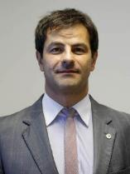
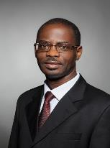
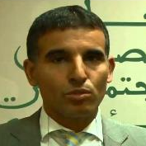
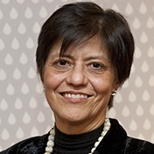
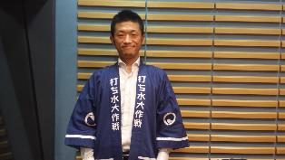
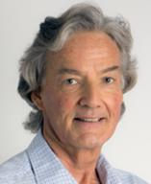
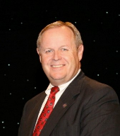
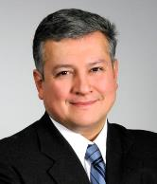
THE PREPARATORY PROCESS
THE REGIONAL PROCESS COMMISSION
5. Irani Ramos – Ministry of Integration of Brazil (Vice Chair)
4. Abdeslam Ziyad – Ministry of Water Resources of Morocco
1. Osward Chanda – African Development Bank (Chair)
2. Blanca Jimenez Cisneros – UNESCO
3. Kunihiro Moriyasu– Japan Water Forum
8. Gertjan Beekman (IICA)
7. Dale Jacobson – ASCE-EWRI EUA
6. Sergio Campos (IDB)

Slide 4
THE REGIONAL FRAMEWORK
International Steering Committee
International Steering Committee:
Overall decision making
Regional Process Commission:
Overall Guidance and advisory support under ISC
Regional (and Sub-Regional) Groups:
Led by Regional (and sub-Regional) Coordinators
  Supervision of the regions, responsible for preparatory kick-off meetings in the regions (and/or sub-regions), as well as mid-way and final meetings, and to guide and monitor the process at the regional/sub-regional levels
Regional Process Commission
(Chair (AfDB), Vice Chair (Brazilian), 6 Commissioners)
Supported by specific Focal Points (1 from the WWC Secretariat and 1 from the Host Country Secretariat)
1. Africa Region
2. Arab Region (incl. North Africa)
3. Americas
4. Europe Region
5. Mediterranean Region
6. Asia-Pacific
Region
3a. North America
6a. Central Asia
1a. West Africa
3b. Central America and Caribbean
6b. North East Asia
1b. West Africa
3c. South America
6c. South Asia
1c. West Africa
3d. Mexico
6d. South East Asia
1d. West Africa
6e. Oceania & Pacific

Slide 5
THE REGIONAL & THEMATIC PROCESSES
FOCAL POINTS
Theme | Africa | Arab | Asia | Mediterranean | Europe | Americas
Climate | AfDB + GWP - SAF | LAS-TS + ACSAD | ICIMOD | CEDARE + Plan Bleu | IST/UL | IDB + ASCE
People | GWP - EAF + AfDB/AWF | AWC + ACWUA | Japan Sanitation Consortium + WaterAid | IME | WfWP | GWP
Development | GWP - WA | FAO-RNE + CEDARE | FAO + UNESCAP | GWP-MED | SIWI (?) | ANEAS
Urban | GWP - EAF | ACWUA | GWP + UN-Habitat + Singapore PUB | MedCities + Ipemed | IWA + EUREAU | ASCE + ADB
Ecosystems | GWP - CAF | UNESCO - RCO | UNESCO + NARBO + IWC | FIEA + EMWIS | ICPDR | UNESCO-PHI + IICA
Finance | GWP - WA | ACWUA | ADB + UNESCAP | MENBO + OECD | Portugal | Caribank CDB
Notes:
LAS-TS – League of Arab States
ACSAD - Arab Center for the Studies of Arid Zones and Dry Lands
ACWUA -Arab Countries Water Utilities Association Egypt, Jordan, Syria, Lebanon, UAE, Palestine, Bahrain, Kuwait, and Oman
AWC - Arab Water Council
FAO-RNE - FAO Regional Office for Near East and North Africa
CEDADE - Center for Environment and Development for the Arab Region and Europe
UNESCO-RCO – Unesco Regional Coordination Office Middle East
ICIMOD - International Centre for Integrated Mountain Development
NARBO - Network of Asian River Basin Organizations
IWC - International WaterCentre
Singapore PUB – Singapure’s National Water Agency
MENBO - Mediterranean Network of Basin Organizations
IME – Institut Méditerranéen de l’Eau
Plan Bleu - one the Regional Activity Centres of the Mediterranean Action Plan (MAP) of United Nations Environment Programme (UNEP)
MedCities - network of Mediterranean cities created in Barcelona in November 1991
IPEMED – Institut de Prospective economique du Mond Mediterranee
WfWP – Women for Water Partnership (http://www.womenforwater.org/)
SIWI – Stockholm International Water Institute (http://www.siwi.org/)
IWA - International Water Association (http://www.iwa-network.org/)
EUREAU – represent drinking water and waste water service providers (http://www.eureau.org/)
IST/UL

Slide 6
UPDATES AND NEXT STEPS
Europe
Survey to identify topics more relevant topics to be discussed in Europe
Selected case studies (successful and unsuccessful stories), to be included in the European Report and defined a template for them
Identified focal points for each theme
Kick off meeting, The Netherlands, May
2nd consultation meeting in Oporto, Portugal, next 26 September (linking with the European Innovation Partnership on Water Conference 2017, 27-28 Sept., and the Mayors & Water Conference 2017, 29 Sept.
Mediterranean
Kick-off meeting of the Mediterranean Region, Monaco, 11 July
Final draft of the regional report to the WWF8, December
3rd Mediterranean Water Forum, Egypt, 25-26 January

Slide 7
UPDATES AND NEXT STEPS
Sub-regional process consultation meeting for Central Asia, Kazakhstan, 7 - 8 September
Korea International Water Week 2017, Korea, 22 - 23 September
Southeast Asia-Sub-regional consultation meeting, Philippines, 27 - 28 September
Sub-regional process consultation meeting for South Asia, Bangladesh, 7 - 8 October
Asia-Pacific Regional Process Wrap-up meeting (as part of 3 Asia-Pacific Water Summit), Myanmar, 11 – 12 Dec
Asia/Pacific
3rd Pacific Water & Wastewater Ministers Forum (Oceania & Pacific Sub-Regional Meeting), Singapore, 31st May
Asia-Pacific Kick-Off Meeting, Samoa, 8th August
Arab
Arab Water Forum Kickoff April 20, 2017
Second Meeting of the preparatory committee July 5, 2017
AWF 4 : culmination of the process November 2017, Cairo
Final draft of the regional report to the WWF8 till start of February 2018

Slide 8
UPDATES AND NEXT STEPS
Sub-regional consultative meetings planned as follows:
  Central - 28-30 July 2017; Brazzaville
  East - 2- 4 August 2017; Addis Ababa
  West - 17 - 18 Aug 2017; Ouagadogou
Regional validation of sub-regional findings planned for 15 Dec 2018 at the latest
Draft Regional report – end January 2018
Africa
Consultants to support report preparation identified and negotiations held for 4 subregions
Americas
South America Kick-off Meeting, 11 May
South America Medium Term Meeting, 11 May
Central America & Caribbean Kick-off Meeting, 2 August
Brazil Meetings for South America Regional Process, 15 – 24 August
Public call for good practices in water use and sanitation, 21 July – 28 August
Americas Wrap-up Meeting, Bahamas, 21 – 22 September

Slide 9
ROADMAP
Sept. 15th
Oct. 15th
Oct. 31st
Sept. 30th
Nov. 15th
Nov. 30th
Dec. 15th
Dec. 31st
Review Plans and Budgets
Recruit Consultants
Regional Wrap-up Meetings
Sessions Design
1st
2nd
Theme Coord – Reg. Focal Points Meetings
Regional Reports concluded
(pre-Forum)

Slide 10
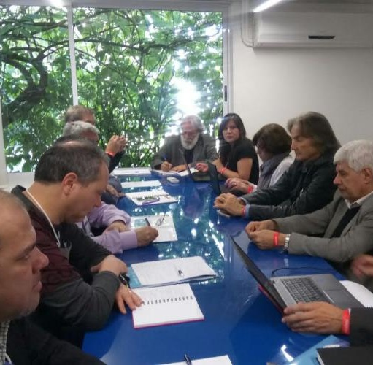
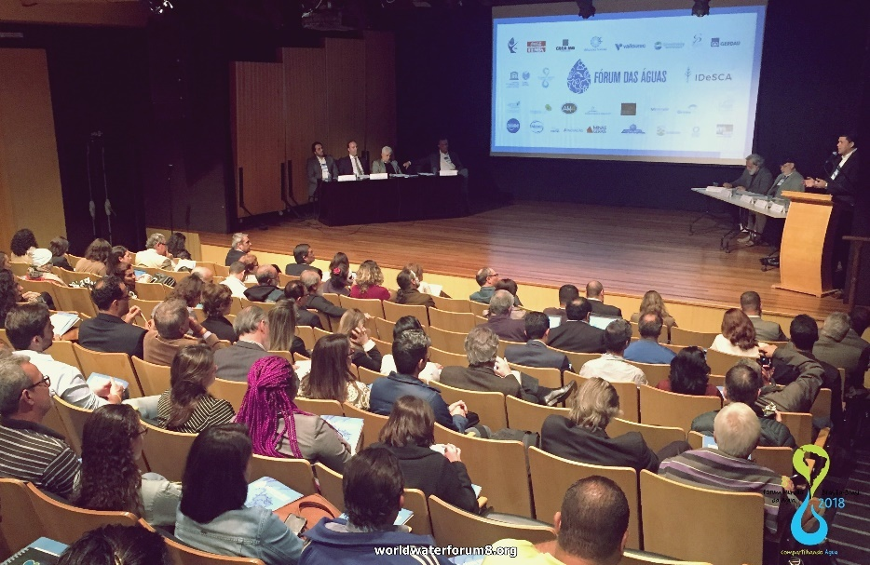
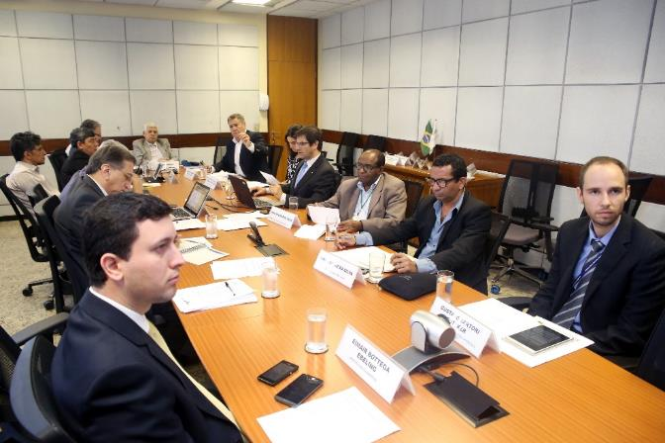
Regional Process – Focal point nomination
South America IHP Coordination Meeting (July, Inhotim – MG)
South America open meeting (July, Inhotim – MG)
Political Process representatives and the Citizens’ Forum Chair attended to the events
Brazilian IHP Coordination Meeting (August, Brasilia)

Slide 11
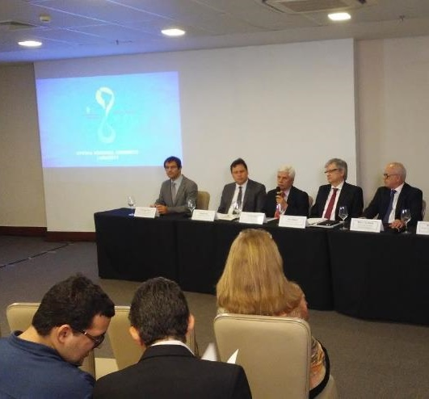
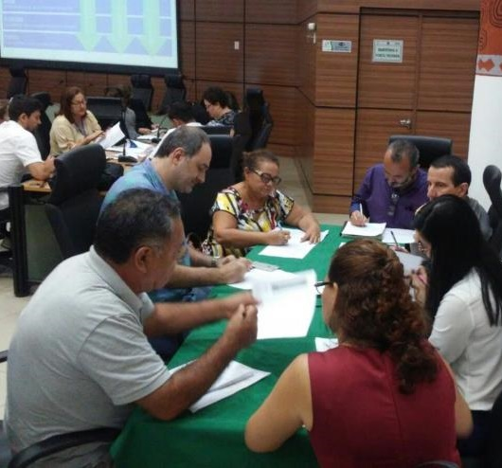
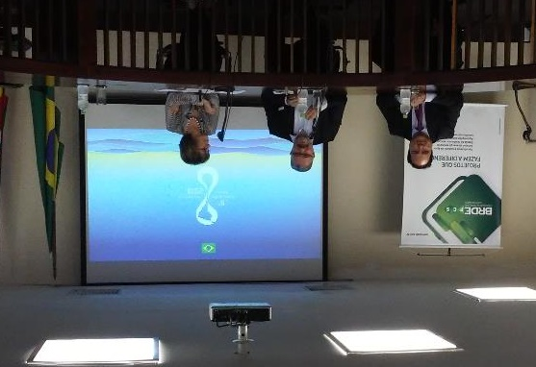
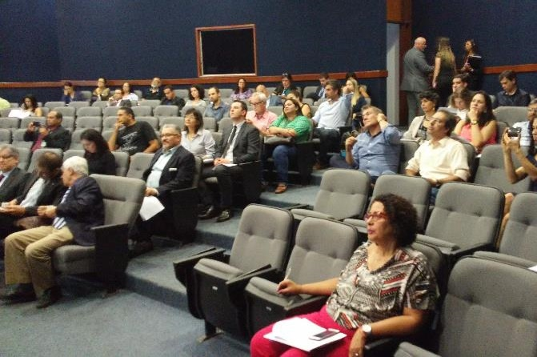
Regional Process – Focal point nomination
Northeast workshop (August, Recife)
Vice-Minister of National Integration
Director of National Water Agency
Brazilian states water&clima authorities
53 attendees
North workshop (August, Belém)
Vice-Minister of National Integration
Director of National Water Agency
Brazilian states water&clima authorities
72 attendees
South workshop (August, Porto Alegre)
Brazilian states water&clima authorities
National Water Agency representatives
17 attendees
Center-west workshop (August, Brasília)
Vice-Minister of National Integration
National Water Agency Directors
Brazilian ministries representatives
39 attendees

Slide 12
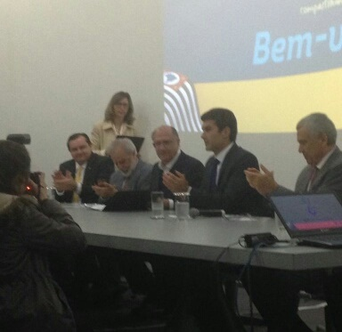
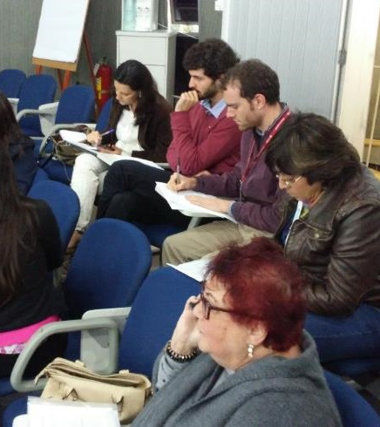
Regional Process – Focal point nomination
Southeast workshop (August, São Paulo)
Minister of National Integration
Governor of São Paulo State
President of the World Water Council
President of the São Paulo Sanitation Company (Sabesp)
National Water Agency representatives
Brazilian states water&clima representatives
117 attendees
Total of 298 attendees
Online contributions possible before August 28th

Slide 13








Organization
Support

